Slide 1
Gravity
Section 1-2

Slide 2
Gravity
Force that attracts all objects towards each other
Measured in Newtons
Causes objects to fall towards Earth
Strength depends on the mass of the objects and the distance between them

Slide 3
Mass
As mass increases, the force of gravity increases.
Earth has a strong gravitational pull on us and on the moon because it is so much bigger.

Slide 4
Mass vs. Weight
Mass is the amount of matter in an object; does not change with location.
Weight is the force of gravity on an object; can change with location

Slide 5
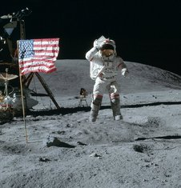
Why do we weigh less on the moon?
We would weigh 1/6 of our weight if we were on the moon.
Reason: Moon is smaller than Earth so it has less of a gravitational pull on us.

Slide 6
Distance
As the distance between each object increases, the force of gravity decreases.
Ex: Mars has less of a gravitational pull on our moon than Earth does because it is further away.

Slide 7
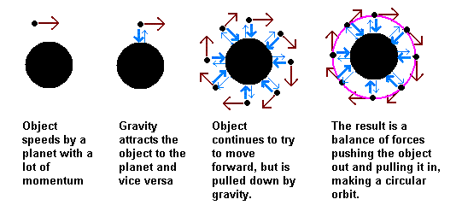
How does the moon stay in orbit around Earth?
Because of gravity and inertia!
Gravity pulls the moon towards Earth and inertia keeps it moving ahead.

